Slide 1
Java Servlet
Dr. Rajeshree Khande,
Associate Head, School of Computer Science,
MIT-World Peace University

Slide 2
Assessment
Adv. Java Theory - Class Continuous Assessment
Mid Term Examination (Online) | Class Test | Class Participation | Assignments | Total
20 | 10 | 10 | 10 | 50
Lab on Adv. Java - Lab Continuous Assessment
lab Test | Mini Project & Research Paper | Lab Assignments | Total
10 | 30 | 10 | 50

Slide 3
What we will learn?
- Introduction to Servlet and Hierarchy of Servlet,
- Life cycle of servlet,
- Tomcat configuration (Note: Only for Lab Demonstration),
- Handing get and post request (HTTP),
- Handling a data from HTML to servlet,
- Retriving a data from database to servlet,
- Session tracking – User Authorization,
- URL rewriting, Hidden form fields,
- Cookies and HttpSession

Slide 4
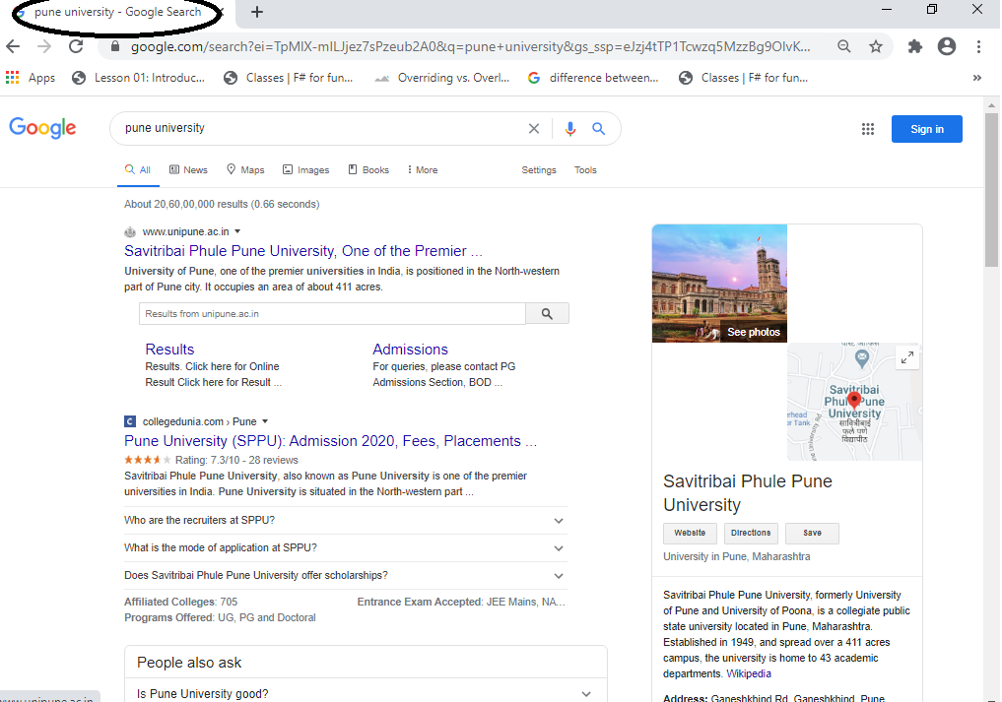
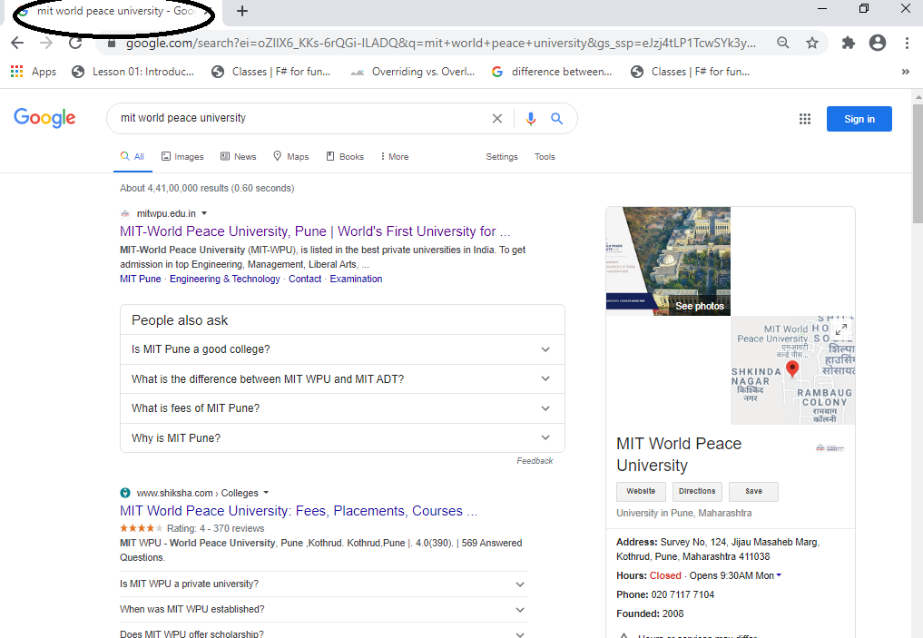
Dynamic Web Content
Dynamic web content allows different data to be shown on the same web page
For example, the Google search result page is the same page that loads different data based on the search terms

Slide 5




Front-End vs Back-End
Java – Servlets, JSPs, JavaBeans, Enterprise Java Beans (EJBs) ,.NET – C#,PHP, Ruby,Python,Server-side JavaScript – node.js,CGI – C, Perl
HTML ,CSS, JavaScript
Request web page
Return HTML, CSS, JavaScript
Web Browser
Web Server

Slide 6
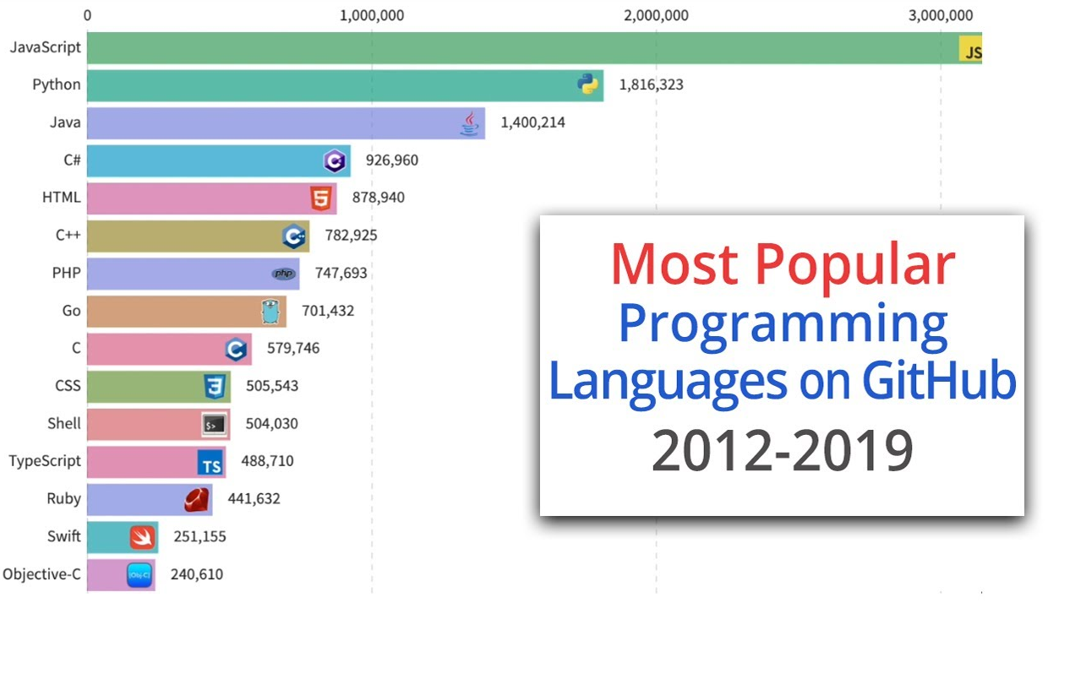
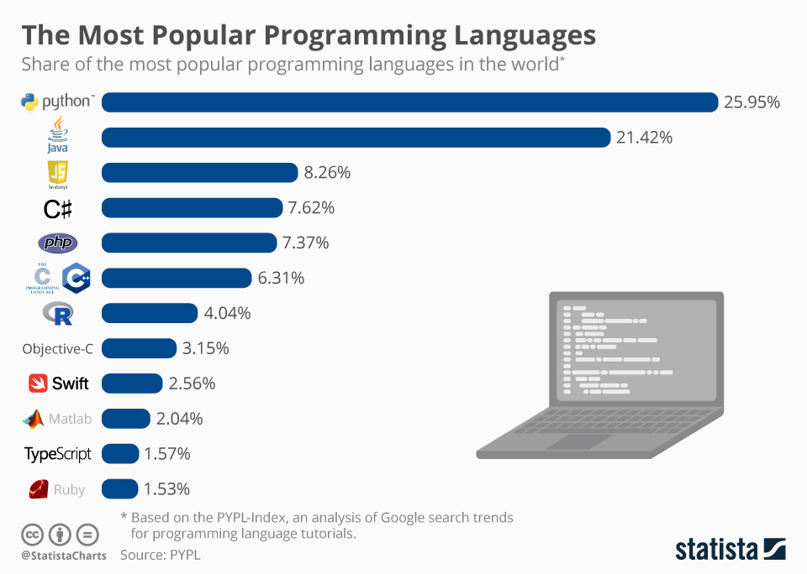
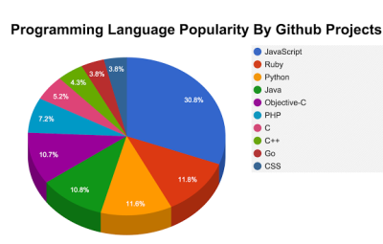
Most Population : Programming Language on GitHub

Slide 7
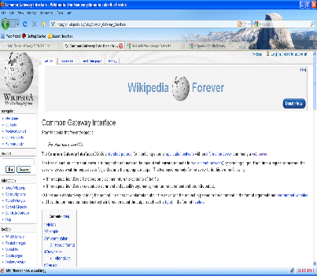
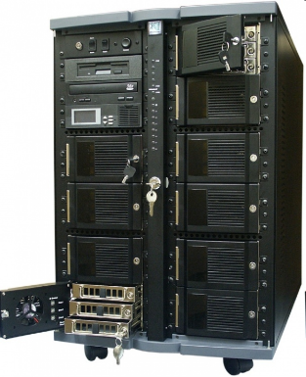
What is Java Servlet?
A servlet is a Java program which outputs an html page; it is a server-side technology
HTTP Request
Server-side Request
Java Servlet
Java Server Page
HTTP Response
Response Header +
Html file
Browser
Web Server
servlet container (engine) - Tomcat

Slide 8
What is Java Servlet?
A servlet is a Java program which outputs an html page; it is a server-side technology
Servlet technology is used to create a web application (resides at server side and generates a dynamic web page).
Servlet technology is robust and scalable because of java language.
Before Servlet, CGI (Common Gateway Interface) scripting language was common as a server-side programming language.
Servlet is an API that provides many interfaces and classes including documentation.
Servlet is an interface that must be implemented for creating any Servlet.
Servlet is a class that extends the capabilities of the servers and responds to the incoming requests. It can respond to any requests.
Servlet is a web component that is deployed on the server to create a dynamic web page.

Slide 9
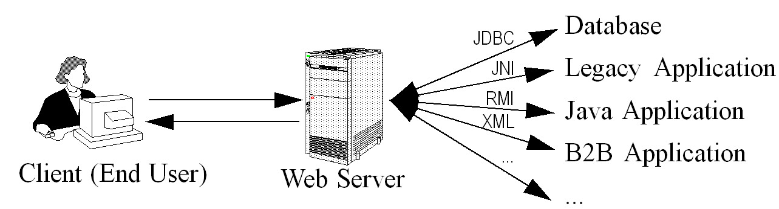
Why Servlet?
Big applets require long download time
Applets do not have access to all the system resources
Server-side Java solves problems that applets face
Code executed on the server side and only the results sent to client
Servlets can access legacy applications and data sources

Slide 10
Why Servlet?
There are many advantages of Servlet over CGI.
The web container creates threads for handling the multiple requests to the Servlet.
Threads have many benefits over the Processes such as they share a common memory area, lightweight, cost of communication between the threads are low.
Servlets are executed within the Java Virtual Machine
Because the servlet is running on the server side, it does not depend on browser compatibility

Slide 11
Advantages of Servlets
Efficiency
More efficient – uses lightweight java threads as opposed to individual processes
Persistency
Servlets remain in memory
Servlets can maintain state between requests
Portability
Since servlets are written in Java, they are platform independent
Robustness
Error handling, Garbage collector to prevent problems with memory leaks
Large class library – network, file, database, distributed object components, security, etc.

Slide 12
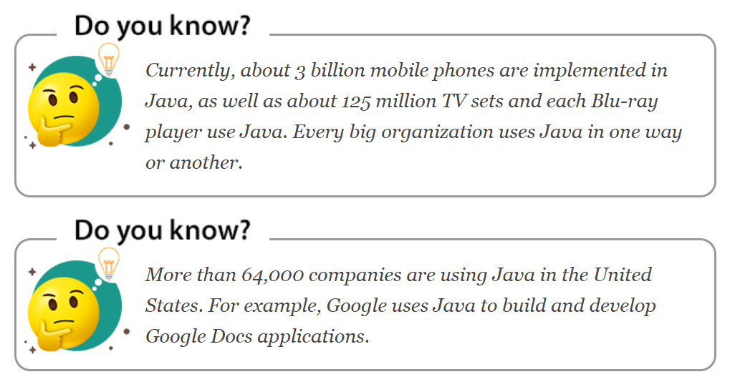
Companies like Naukri, Jabong, Google, Myntra, Flipkart, Trivago, goibibo, TripAdvisor, Spotify, Uber, TCS, Infosys, HCL, Wipro, Pinterest, eBay, etc use Java.

Slide 13
Example –Web Based Application
web-based applications are HelpDesk , Student info Management system, online forms, online slam book ,shopping carts, online chocolate shop site, Gmail, Google Sheets, Google Slides, Online Library, and many more
Java servlets can be used to build anything

Slide 14
Servlet Architecture
2. web server receives the request.
Web Container
1. clients send the request to the web server.
HTTP Request
Web Browser
Web Server
3 send request to the corresponding servlet.
Servlet Program
4. processes the request and generates the response in the form of output
6. sends the response back to the client
HTTP Response
5. servlet sends the response
7. Browser displays output on the screen
DB

Slide 15
Servlet Architecture
1. Client
Web browser acts as a Client.
Client or user connected with a web browser.
The client is responsible for sending requests or HttpRequest to web server and processing responses received by the Web server.
2. Web Server
Web server controls how web user access hosted files.
Responsible for processing user request and responses.
Server is a software it understand URLs and HTTP protocol.
Whenever browser need to host file on the webserver process client request using HTTP request, if it finds requested file sends it back to browser through HTTP Response.
.
.
3. Web Container
Component in the webserver which interacts with Java servlets.
It responsible for managing the lifecycle of servlets and it also performs the URL mapping task.
It handles the requests of servlets, JSP and other files at the server-side.
The important tasks performed by servlets are loading and unloading servlets, creating and managing requests and response objects
the overall task of web container is servlet management.

Slide 16
Servlet Request Flow
The client sends a request.
Web Server accepts the request and forwards it to the web container.
Web container searches web.xml file for request URL pattern and gets the address of the servlet.
If the servlet is not yet instantiated it will be instantiated and initialized by calling the init() method.
The container calls public service() by passing ServletRequest and ServletResponse objects.
Public service() method typecast ServletRequest and ServletResponse object to HttpServletRequest and HttpServletResponse objects respectively.
Public service() method calls protected service().
Protected service() method checks the client request & corresponding do___() method is called.
Request is handled by sending the result generated by do___() to the client.

Slide 17




Servlet 3-Tier Architecture
Client
Server
Database

Slide 18
Servlets Packages?
Java Servlets are Java classes run by a web server that has an interpreter that supports the Java Servlet specification.
Servlets can be created using the javax.servlet and javax.servlet.http packages, which are a standard part of the Java's enterprise edition, an expanded version of the Java class library that supports large-scale development projects.
These classes implement the Java Servlet and JSP specifications.
Java servlets have been created and compiled just like any other Java class.
After you install the servlet packages and add them to your computer's Classpath, you can compile servlets with the JDK's Java compiler or any other current compiler.

Slide 19
Free Servlet and JSP Engines
Apache Tomcat
http://jakarta.apache.org/tomcat/
Allaire/Macromedia JRun
http://www.macromedia.com/software/jrun/
New Atlanta ServletExec
http://www.servletexec.com/
Gefion Software LiteWebServer
http://www.gefionsoftware.com/LiteWebServer/

Slide 20
Setting up Java Development Kit : Windows NT/2000/XP
Download JDK from Oracle's Java site https://www.oracle.com/java/technologies/javase-jdk12-downloads.html
For Windows and installed the SDK in C:\jdk12.0.2, you would put the following line in your C:\autoexec.bat file
Or right-click on My Computer, select Properties, then Advanced, then Environment Variables. Then, you would update the PATH value and press the OK button.
set PATH = C:\jdk12.0.2\bin;%PATH%
set JAVA_HOME = C:\jdk12.0.2

Slide 21
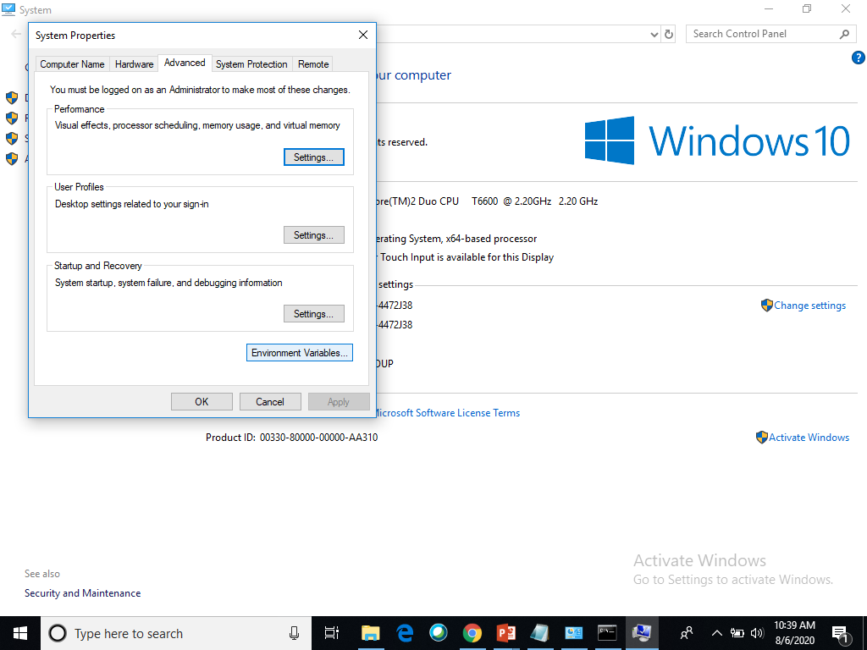
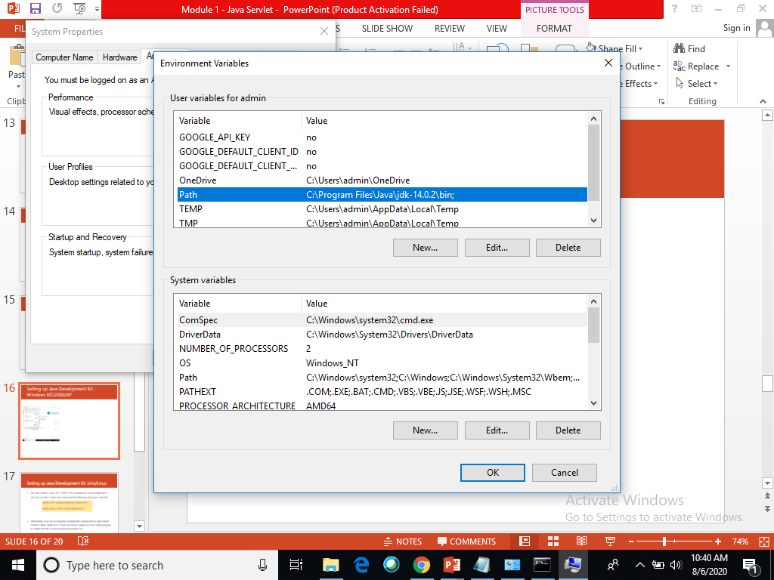
Setting up Java Development Kit : Windows NT/2000/XP

Slide 22
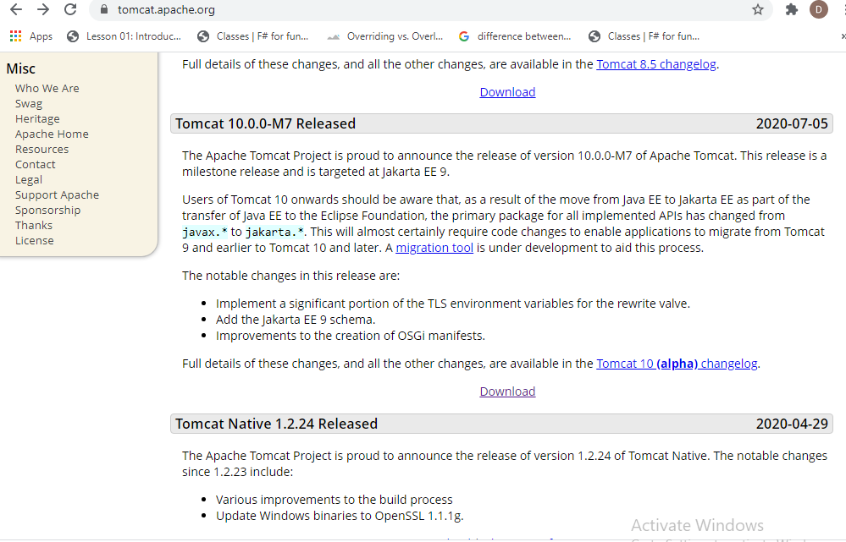
Installing Tomcat 9 on Windows
Prerequisites : JDK or JRE will need to be installed on the Windows Server before you can configure Tomcat 9
Open your browser and head over to https://tomcat.apache.org. Scroll down a little to locate and click on the Tomcat 10 link located within the left menu bar.
Click on Download

Slide 23
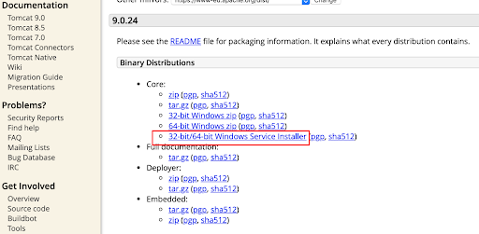
Installing Tomcat 9 on Windows
Next, locate the 32-bit/64-bit Windows Service Installer link and click on it.

Slide 24
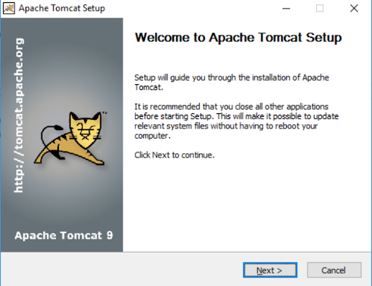
Installation
Step 1. The first page of the install explains what the installer will do and what to expect. Go ahead and click Next on the first page.

Slide 25
Installation
Step 2. Before you can start the install, you must agree to the Apache License Agreement for the Tomcat 10 service

Slide 26
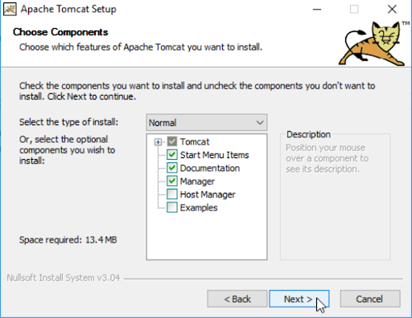
Installation
“Select the type of install” dropdown list and choose the “Full” install option and then click Next.

Slide 27
Tomcat's Sub-Directories
bin: contains the binaries and scripts (e.g., startup.bat and shutdown.bat for Windows; startup.sh and shutdown.sh for Unixes and macOS).
webapps: contains the webapps to be deployed. You can also place the WAR (Webapp Archive) file for deployment here.
lib: contains the Tomcat's system-wide library JAR files, accessible by all webapps. You could also place external JAR file (such as MySQL JDBC Driver) here.
conf: contains the system-wide configuration files, such as server.xml, web.xml, and context.xml.
logs: contains Tomcat's log files. You may need to check for error messages here.
work: Tomcat's working directory used by JSP, for JSP-to-Servlet conversion.

Slide 28
Format of a web application
Web applications are stored in the webapps folder, either as a folder or as a .war archive
A web application (either a folder or a .war archive) must contain the following files:
WEB-INF folder
WEB-INF\web.xml: a configuration file
Optionally the WEB-INF folder can contain the following subfolders:
classes: which contain servlets
lib: which contains jars used by the web application
html, jsp and resource files can be placed anywhere in the web application home folder
servlets must be placed in the folder or subfolders of WEB-INF\classes

Slide 29
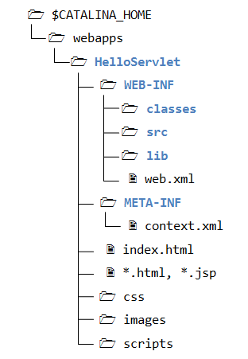
Structure of CATALINA_HOME directory

Slide 30
Configuring servlets : web.xml
web.xml
<servlet>
<servlet-name>ServletsName</servlet-name>
<servlet-class>The_Class_Name_of_the_Servlet</servlet-class>
</servlet>
<servlet-mapping>
<servlet-name> ServletsName </servlet-name>
<url-pattern>/URL_of_the_servlet</url-pattern>
</servlet-mapping>
For java servlets additional lines must be placed in the web.xml file:

Slide 31
Servlets Packages?
Java Servlets are Java classes run by a web server that has an interpreter that supports the Java Servlet specification.
Servlets can be created using the javax.servlet and javax.servlet.http packages, which are a standard part of the Java's enterprise edition, an expanded version of the Java class library that supports large-scale development projects.
These classes implement the Java Servlet and JSP specifications.
Java servlets have been created and compiled just like any other Java class.
After you install the servlet packages and add them to your computer's Classpath, you can compile servlets with the JDK's Java compiler or any other current compiler.

Slide 32
Configuring servlets : web.xml
web.xml
<servlet>
<servlet-name>ServletsName</servlet-name>
<servlet-class>The_Class_Name_of_the_Servlet</servlet-class>
</servlet>
<servlet-mapping>
<servlet-name> ServletsName </servlet-name>
<url-pattern>/URL_of_the_servlet</url-pattern>
</servlet-mapping>
For java servlets additional lines must be placed in the web.xml file:
web. xml defines mappings between URL paths and the servlets that handle requests with those paths

Slide 33
Servlet API and Tomcat Container
The Servlet API provides interfaces and classes that are required to built servlets.
These interfaces and classes are group into the following two packages
javax.servlet
javax.servlet.http
these packages are not part of Java core packages, they are standard extension provides by Tomcat. Therefore, they are not included with Java SE 6
The javax.servlet package contains many interfaces and classes that are used by the servlet or web container. These are not specific to any protocol.
The javax.servlet.http package contains interfaces and classes that are responsible for http requests only.

Slide 34
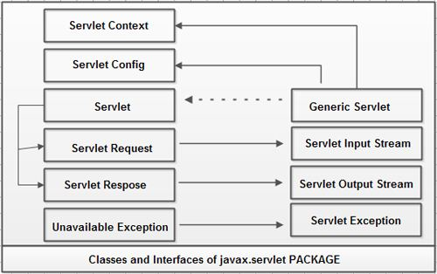
javax.servlet PACKAGE
contains a number of interfaces and classes that launch the framework in which servlets operate.
The classes and interface in this package are protocol independent.

Slide 35
javax.servlet Interfaces & Interfaces
Servlet
ServletConfig
Interfaces
ServletContext
ServletRequest
Servlet
ServletResponse
GenericServlet
ServletlnputStream
Classes
ServletOutputStream
ServletException
UnavailableException

Slide 36
javax.servlet Interfaces
Interfaces | Description
Servlet | Declares life cycle methods that all servlets must implement.
ServletConfig | Allows servlets to get initialization parameters
ServletContext | Allows servlets to communicate with its servlet container.
ServletRequest | Provides client request information to a servlet.
ServletResponse | Sending a response to the client.

Slide 37
javax.servlet Classes
Classes | Description
GenericServlet | Provides a basic implementation of the Servlet interface for protocol independent servlets
ServletlnputStream | Provides an input stream for reading binary data from a client request.
ServletOutputStream | Provides an output stream for sending binary data to the client.
ServletException | Defines a general exception, a servlet can throw when it encounters difficulty.
UnavailableException | Indicates that a servlet is not available to service client request.

Slide 38
Servlet Architecture
There are two types of Servlets-
1.Generic Servlets
2.HTTPServlets.
Servlets can be created in three possible ways
Implementing Servlet Interface
Extending Generic Servlet.
Extending HTTPServlet.

Slide 39
Servlet API
The javax.servlet and javax.servlet.http packages represent interfaces and classes for servlet api.
The javax.servlet package contains many interfaces and classes that are used by the servlet or web container. These are not specific to any protocol.
The javax.servlet.http package contains interfaces and classes that are responsible for http requests only.

Slide 40
Servlet API
The javax.servlet and javax.servlet.http packages represent interfaces and classes for servlet api.
The javax.servlet package contains many interfaces and classes that are used by the servlet or web container. These are not specific to any protocol.
The javax.servlet.http package contains interfaces and classes that are responsible for http requests only.

Slide 41
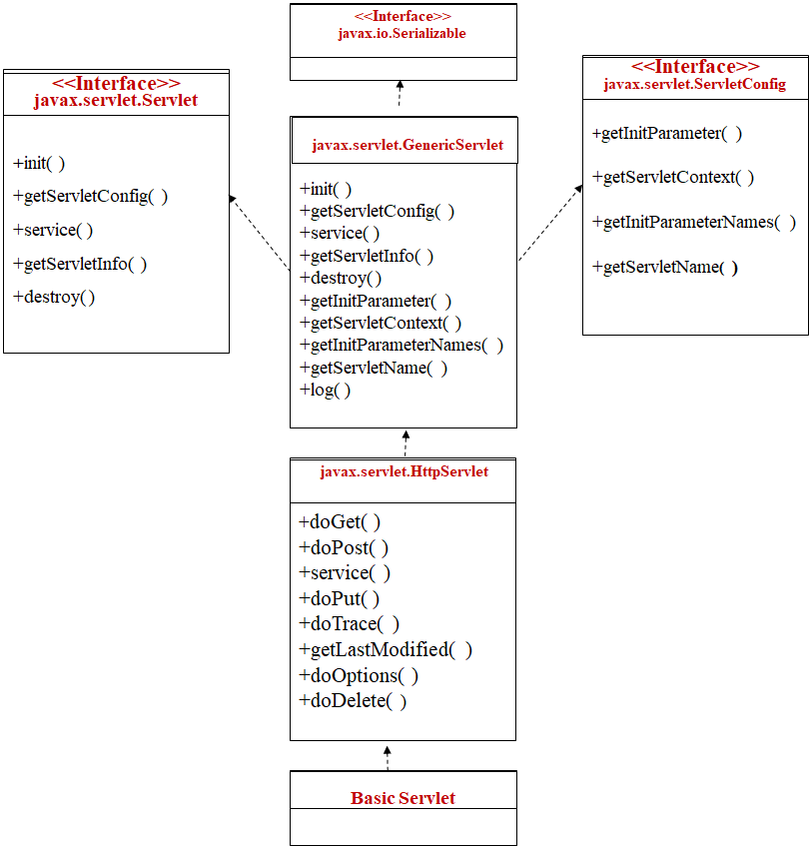
Object model of Servlet Framework

Slide 42
The Servlet Interface and Request and Response Objects
A Java servlet, implements the javax.servlet.Servlet interface.
This interface specifies methods to initialize a servlet, process requests, get the configuration and other basic information of a servlet, and terminate a servlet instance.
For Web applications, you can implement the Servlet interface by extending the javax.servlet.http.HttpServlet abstract class. (Alternatively, for protocol-independent servlets, you can extend the javax.servlet.GenericServlet class.)
The HttpServlet class includes the following methods:

Slide 43
The Servlet Interface and Request and Response Objects
init(...): Initialize the servlet.
destroy(...): Terminate the servlet.
doGet(...): Execute an HTTP GET request.
doPost(...): Execute an HTTP POST request.
doPut(...): Execute an HTTP PUT request.
doDelete(...): Execute an HTTP DELETE request.
service(...): Receive HTTP requests and, by default, dispatch them to the appropriate doXXX() methods.
getServletInfo(...): Retrieve information about the servlet.

Slide 44
GenericServlet & HttpServlet
HttpServlet class is extended from GenericServlet class
GenericServlet.service() method has been defined as an abstract method
The two objects that the service() method receives are ServletRequest and ServletResponse
ServletRequest Object Holds information that is being sent to the servlet
ServletResponse Object Holds data that is being sent back to the client

Slide 45
GenericServlet & HttpServlet
Unlike the GenericServlet, when extending HttpServlet, don’t have to implement the service() method. It is already implemented for you
When HttpServlet.service( ) is invoked, it calls doGet( ) or doPost( ), depending upon how data is sent from the client
HttpServletRequest and HttpServletResponse classes are just extensions of ServletRequest and ServletResponse with HTTP-specific information stored in them

Slide 46
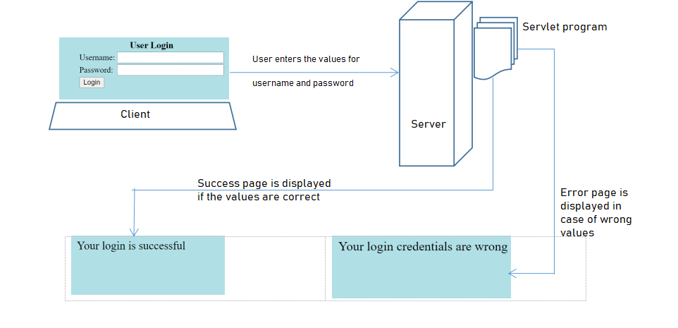
Sample Java Servlet Application

Slide 47
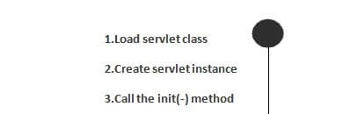
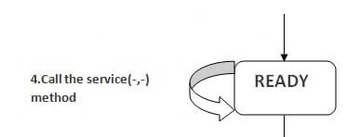
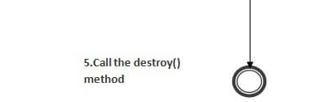
Servlet Life Cycle
The web container maintains the life cycle of a servlet instance
Load the servlet class
Create Servlet Instance
Call init() method
Service() method is invoked.
Destroy() method is invoked.
Called only once
Handles multiple request and sends response
Called 0 or more times
Called only once

Slide 48
Servlet Life Cycle
The servlet class is loaded when the first request for the servlet is received by the web container.
Servlet
.class
The web container creates the instance of a servlet after loading the servlet class. The servlet instance is created only once in the servlet life cycle
Garbage Collection finalize()
Instantiation
new()
Client Request
Terminate
destroy()
Initialization
init(….)
There are three states of a servlet: new, ready and end.
The servlet is in new state if servlet instance is created.
After invoking the init() method, Servlet comes in the ready state.
In the ready state, servlet performs all the tasks.
When the web container invokes the destroy() method, it shifts to the end state.
Ready
service()
Form
doGet(..) doPost(..)

Slide 49
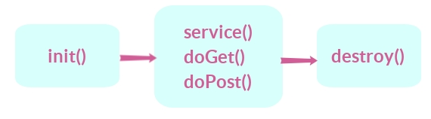
Servlet Life Cycle : 3 main methods
Methods
init()
Service()
destroy()

Slide 50
init() method
The web container calls the init() method only once after creating the servlet instance.
The init() method is used to initialize the servlet.
It is the life cycle method of the javax.servlet.Servlet interface.
Syntax of the init() method
public void init(ServletConfig config) throws ServletException

Slide 51
service() method
The web container calls the service method each time when request for the servlet is received.
If servlet is not initialized, it follows the first three steps then calls the service method.
If servlet is initialized, it calls the service method.
Servlet is initialized only once.
The syntax of the service() :
public void service(HttpServletRequest request, HttpServletResponse response) throws ServletException, IOException
The service () method is called by the container and service method invokes doGet, doPost, doPut, doDelete, etc. methods as appropriate.

Slide 52
service() method
Override either doGet() or doPost() depending on what type of request you receive from the client.
The doGet() and doPost() are most frequently used methods with in each service request.
doGet() Method | doPost() Method
A GET request results from a URL or from an HTML form Syntax | A POST request results from an HTML Syntax
public void doGet(HttpServletRequest request, HttpServletResponse response)
throws ServletException, IOException
public void doPost(HttpServletRequest request, HttpServletResponse response)
throws ServletException, IOException

Slide 53
destroy() method
The web container calls the destroy method before removing the servlet instance from the service.
Destroy() method clean up any resource for example memory, thread etc.
The syntax of the destroy method
public void destroy()

Slide 54
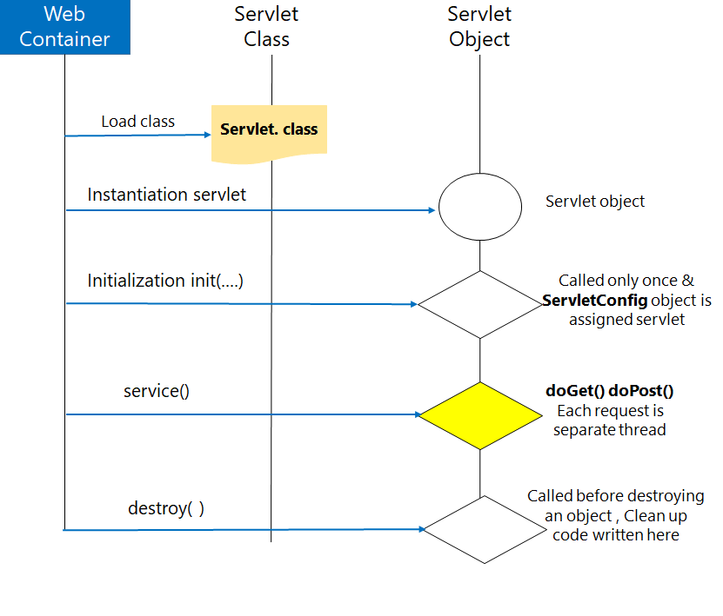
Servlet Architecture Diagram:
The HTTP requests coming to the server are delegated to the servlet container.
The servlet container loads the servlet before invoking the service() method.
Then the servlet container handles multiple requests by spawning multiple threads, each thread executing the service() method of a single instance of the servlet.

Slide 55
Difference Between GenericServlet & HttpServlet
GenericServlet | HttpServlet
GenericServlet is protocol independent | HttpServlet is a protocol dependent
GenericServlet can handle all types of protocols | HttpServlet handle only HTTP specific protocols
GenericServlet belongs to javax.servlet package | HttpServlet belongs to javax.servlet.http package
GenericServlet is an abstract class which extends Object and implements Servlet, ServletConfig and java.io.Serializable interfaces | HttpServlet is an abstract class which extends GenericServlet and implements java.io.Serializable interface.
GenericServlet supports only service() method does not contain doGet() and doPost() methods | HttpServlet support also doGet(), doPost(), doHead() methods (HTTP 1.0) plus doPut(), doOptions(), doDelete(), doTrace() methods (HTTP 1.1).

Slide 56
Retrieve Client Input Data in Servlet
When client send some input data to the servlet, that data will be available in the form of request object.
We can retrieve that input data through HttpServletRequest or ServletRequest interface.
There are 4 methods to retrieve the client data which is present in request object.
All these methods are present in javax.servlet.ServletRequest interface, and HttpServletRequest is the sub interface of ServletRequest,
public String getParameter(“input variable”);
public Enumeration getParameterNames();
public Map getParameterMap();

Slide 57
Example : getParameter()
index.html
<HTML>
<HEAD><TITLE>Form Servlet</TITLE></HEAD>
<BODY>
<FORM METHOD = GET ACTION= "http://localhost:8080/Project1/FormServlet">
Please Enter Your Name:
<INPUT TYPE = TEXT NAME = "name"><p>
<INPUT TYPE = SUBMIT>
</FORM>
</BODY></HTML>

Slide 58
Example : getParameter(): method returns the value of the given parameter.
FormServlet.java
import java.io.*;
import javax.servlet.*;
import javax.servlet.http.*;
public class FormServlet extends HttpServlet {
public void doGet(HttpServletRequest request, HttpServletResponse response) throws ServletException, IOException
{
res.setContentType("text/html");
PrintWriter out = response.getWriter();
String Your_name = request.getParameter("name");
out.println("<HTML>");
out.println("<HEAD>"+"<TITLE>"+"Hello" + Your_name + "</TITLE></HEAD>");
out.println("<BODY>");
out.println("Hello " + Your_name);
out.println("</BODY>" + "</HTML>");
}
}

Slide 59
Example 2: getParameterNames() - Getting parameter names and values
getParameterNames(): Returns an Enumeration of String objects containing the names of the parameters contained in this request
Enumeration interface defines the methods by which we can obtain one element at a time in a collection of objects.
boolean hasMoreElements( )
it must return true while there are still more elements to extract, and false when all the elements have been enumerated.
Object nextElement( )
This returns the next object in the enumeration as a generic Object reference.

Slide 60
Index.html
<HTML>
<HEAD><TITLE>Form Servlet</TITLE></HEAD>
<BODY>
<FORM METHOD = GET ACTION= "http://localhost:8080/Project2/FormServlet2">
<form action="details" method="get">
Please Enter Your Name: <input type="text" name="uname"><br>
Enetr Age: <input type="text" name="uage"><br>
<input type="submit" value="submit">
</form>
</BODY></HTML>

Slide 61
FormServlet2.java
import java.io.*;
import javax.servlet.*;
import javax.servlet.http.*;
import java.util.*;
public class FormServlet2 extends HttpServlet {
public void doGet(HttpServletRequest req,HttpServletResponse res)
throws ServletException,IOException {
PrintWriter out=res.getWriter();
res.setContentType("text/html");
Enumeration en=req.getParameterNames();
while(en.hasMoreElements())
{
Object obj=en.nextElement();
String param=(String)obj;
String pvalue=req.getParameter(param);
out.println("Parameter Name: "+ param + " " +" Parameter Value: "+pvalue);
}
out.close();
}
}

Slide 62
Map getParameterMap()
Returns an immutable java.util.Map containing parameter names as keys and parameter values as map values.
The keys in the parameter map are of type String.
The values in the parameter map are of type String array.
For Servlets, parameters are contained in the query string (GET request) or request body (POST request).
If the request has no parameters, the method returns an empty Map.

Slide 63
Index.html
<HTML>
<HEAD><TITLE>Form Servlet</TITLE></HEAD>
<BODY>
<FORM METHOD = post ACTION= "http://localhost:8080/Project3/FormServlet3">
Name:<input type="text" name="name">
Country:<input type="text" name="country"><br>
Hobbies: <br>
<input type="checkbox" name="Hobbies" value="Reading">Reading<br>
<input type="checkbox" name="Hobbies" value="Movies">Movies<br>
<input type="checkbox" name="Hobbies" value="Writing">Writing<br>
<input type="submit" value="Submit">
</form>
</BODY></HTML>

Slide 64
FormServlet3.java
public class FormServlet3 extends HttpServlet
{
public void doPost(HttpServletRequest request,HttpServletResponse response)throws ServletException,IOException
{
PrintWriter out = response.getWriter();
try
{
Map<String,String[]> inputParams = null;
inputParams = request.getParameterMap();
if (inputParams != null)
{
out.println("Total number of parameters: " + inputParams.size());
Iterator<String> iter = inputParams.keySet().iterator();
while (iter.hasNext())
{
String key = (String) iter.next(); // gets the parameter name
String[] values = (String[]) inputParams.get(key); // returns the value of a parameter name
for (int i = 0; i < values.length; i++)
{
out.println("Parameter Name="+ key + ", Value=" + values[i]+"</br>");
}
}
}
} catch (Exception e) {
// TODO Auto-generated catch block
e.printStackTrace();
} finally {
out.close();
}
}}

Slide 65
Request Header: javax.servlet.http.HttpServletRequest
Used to pass additional information about the request or itself to the server.
Request header can be used by client to pass useful information.
Following methods of javax.servlet.http.HttpServletRequest of interface are used to get the header information.
getHeaderNames()
getHeader()
Few important request header information which comes from browser side
Accept
Accept-Charset
Accept-Encoding
Accept-Language
Authorization
From
Host
If-Modified-Since.
Range:
Referer:
User-Agent

Slide 66
Request Header: javax.servlet.http.HttpServletRequest
Accept: Specifies the certain media types that are acceptable in the response.
Accept-Charset: Indicates the character sets that are acceptable in the response.
Accept-Encoding: Restricts the content-coding values that are acceptable in the response
Accept-Language: Restricts the set of language that are preferred in the response.
Authorization : Indicates that user agent is attempting to authenticate itself with a server.
From: Contains internet email address for the user who controls the requesting user agent.
Host: Internet host and port number of the resource being requested.
If-Modified-Since: Makes GET method condition. Do not return the requested information if it is not modified since the specified date.
Range: Request one or more sub-range of the entity, instead of the entire entity.
Referer: enables client to specify, for the servers benefit, the address(URL) of the resources from which the Request-URL was obtained.
User-Agent: contains information about the user agent originating the request.

Slide 67
Methods of ServletRequest interface
String getParameter(String name)
Rreturns the value of the given parameter as String or null if the given parameter does not exist
Enumeration getParameterNames()
Returns an Enumeration of Strings objects containing the names of parameters in the request.
String[] getParameterValues(String name)
Returns an array of Strings containing the all the values, the parameters has, returns null if parameter doesn’t have any value.
String getHeader(String name)
Returns the value of the specified request header as a String
int getContentLength()
Returns the length of the request content in bytes
String getProtocol()
Returns the name and version of the protocol the request.
String getQueryString()
Returns the query string that is contained in the request URL after the path
int getIntHeader(String name)
Returns the value of the specified request header as an int.

Slide 68
import java.io.*;
import java.util.*;
import javax.servlet.*;
import javax.servlet.http.*;
public class reqHeader1 extends HttpServlet
{
public void doGet(HttpServletRequest request, HttpServletResponse response) throws ServletException,IOException
{
response.setContentType("text/html");
PrintWriter out = response.getWriter();
out.println("<b>" + "HTTP header Information:<br>" + "</b>");
out.println("<h3>" + "Host Name:" + request.getHeader("Host") + "</h3>");
out.println("<hr>" + "</hr>");
out.println("<h3>" + "Accept:" + request.getHeader("Accept") + "</h3>");
out.println("<hr>" + "</hr>");
out.println("<h3>" + "Accept Language:" + request.getHeader("Accept-Language") + "</h3>");
out.println("<hr>" + "</hr>");
out.println("<h3>" + "Accept Character Set:" + request.getHeader("Accept-Charset") + "</h3>");
out.println("<hr>" + "</hr>");
out.println("<h3>" + "Accept Encoding:" + request.getHeader("Accept-Encoding") + "</h3>");
out.println("<hr>" + "</hr>");
}
}

Slide 69
HttpResponse
1. Writing HTML
The purpose of the HttpResponse object is to represent the HTTP response web application sends back to the browser, in response to the HTTP request
The HttpResponse object has a lot of methods, so we will discuss the most commonly used
The rest you can read from JavaDoc, if you are interested.
PrintWriter out = response.getWriter();
response.setContentType("text/html");
out.println("<html><body> Hello </body></html>");
2. Content Type
PrintWriter out = response.getWriter();
response.setContentType("text/html");
2. Redirecting URL
PrintWriter out = response.getWriter();
response.setContentType("text/html");
response.sendRedirect(“www.google.com");

Slide 70
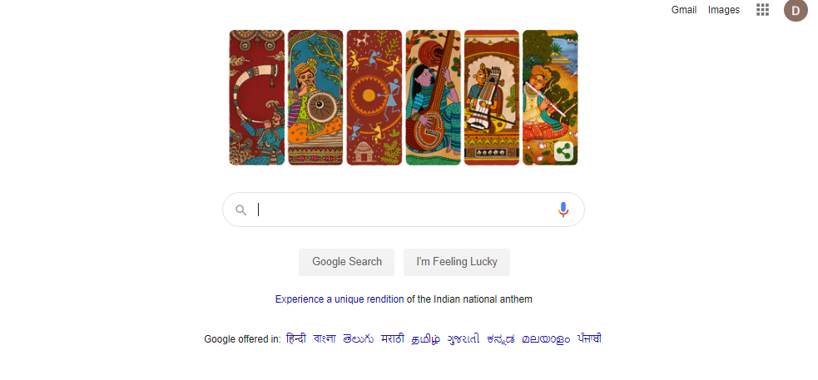
redirectServlet.java
import java.io.*;
import javax.servlet.*;
import javax.servlet.http.*;
public class redirectServlet extends HttpServlet
{
public void doGet(HttpServletRequest request,HttpServletResponse response)
throws ServletException,IOException
{
response.setContentType("text/html");
PrintWriter out=response.getWriter();
response.sendRedirect("http://www.google.com");
out.close();
} }
Servlet program to redirect Request to other URL

Slide 71
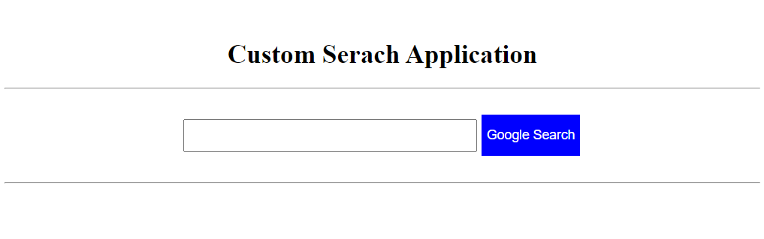
Servlet program for Custom Search
<html>
<head>
<title>sendRedirect example</title>
<style>
.button1{
background-color:blue;
color: white;
text-align: center;
font-size: 16px;
margin: 4px 2px;
Height:50px;
}
</style>
</head>
<body>
<form action="Search">
<br>
<center>
<h1> Custom Serach Application </h1>
<hr>
<br>
<input type="text" name="name" size=50 style="Height: 40px;"/>
<input class="button1" type="submit" value="Google Search" >
<br><br>
<hr></center>
</form>
</body>
</html>
<import java.io.*;
import javax.servlet.*;
import javax.servlet.http.*;
public class Search extends HttpServlet
{
protected void doGet(HttpServletRequest request, HttpServletResponse response)
throws ServletException, IOException {
String name=request.getParameter("name");
response.sendRedirect("https://www.google.co.in/#q="+name);
}
}

Slide 72

: sendRedirect()
In the sendRedirect method existing request and response objects are lost.
It happens on the client side.
request gets transferred to resource outside the application.
works on response object.
transfer to another resource to different domain.
sendRedirect method is slower because extra round trip is required because completely new request is created and old object request is lost.

Slide 73
RequestDispatcher in Servlet
The RequestDispatcher interface defines an object that receives the request from client and dispatches it to the resource(such as servlet, JSP, HTML file). This interface has following two methods:
RequestDispatcher has two methods:
Forward()
forwards a request from a servlet to another resource
Method
Include()
includes the content of a resource in the response

Slide 74
RequestDispatcher in Servlet
The RequestDispatcher interface defines an object that receives the request from client and dispatches it to the resource(such as servlet, JSP, HTML file). This interface has following two methods:
public void forward(ServletRequest request, ServletResponse response):
It forwards the request from one servlet to another resource (such as servlet, JSP, HTML file).
public void include(ServletRequest request, ServletResponse response):
It includes the content of the resource(such as servlet, JSP, HTML file) in the response.

Slide 75
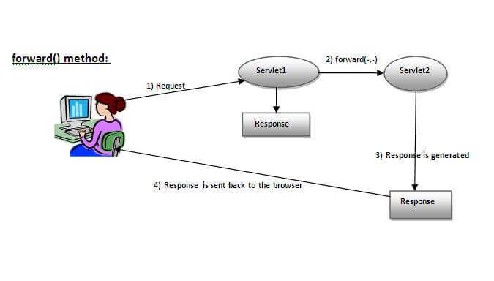
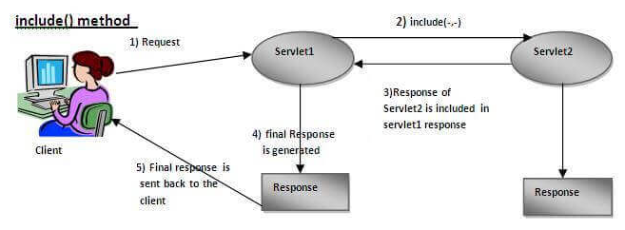
Difference between Forward() & include()
Response of second servlet is sent to the client. Response of the first servlet is not displayed to the user.
Response of second servlet is included in the response of the first servlet that is being sent to the client.
Source : https://www.javatpoint.com/

Slide 76
How to get the object of RequestDispatcher
getRequestDispatcher() method of ServletRequest interface returns the object of RequestDispatcher.
Syntax:
public RequestDispatcher getRequestDispatcher(String resource);
Example:
RequestDispatcher rd=request.getRequestDispatcher("servlet2");
//servlet2 is the url-pattern of the second servlet
rd.forward(request, response); //method may be include or forward

Slide 77
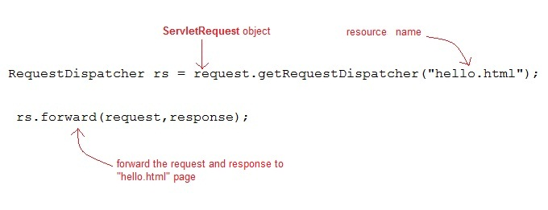
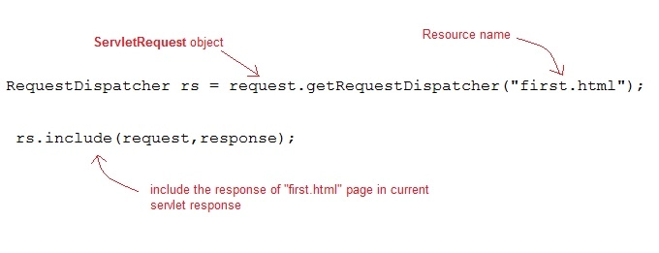
How to get the object of RequestDispatcher :example
Forward()
Include()

Slide 78
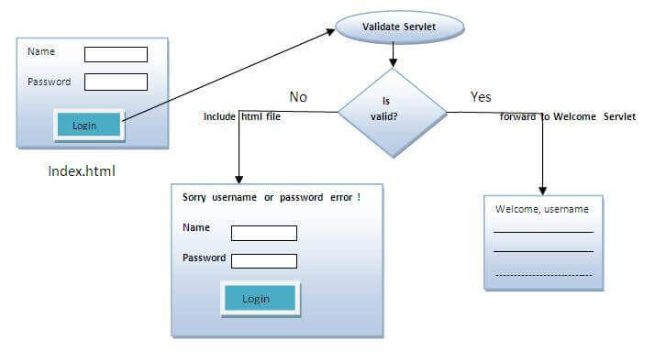
Implementation of login page
Design login page . Validating the password entered by the user. If password is valid , it will forward the request to the Welcome.java, otherwise will show an error message: sorry username or password incorrect…. Please try again!.
We will creat following files
index.html
Validate.java: a servlet class for processing the response. If password is valid, it will forward the request to the welcome servlet.
Welcome.java: a servlet class for displaying the welcome message.
web.xml file: a deployment descriptor file that contains the information about the servlet.

Slide 79
Implementation of login page
Validate.java
username=resquest.getParameter(“uname”)
Password = request.getParameter(pwd)
Index.html
name="uname“
name="pwd"
Invalid
Validation true
Welcome.java
Out.println( “welcome” + username)

Slide 80
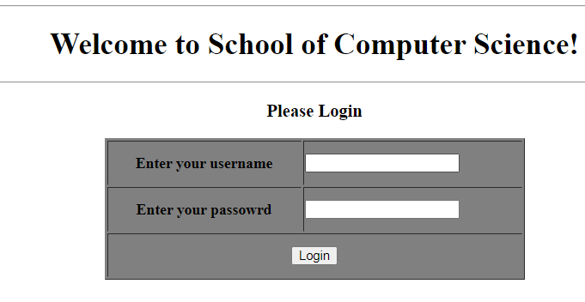
login.html
<html>
<body>
<body>
<form action="servlet1" method="post">
<center>
<hr>
<h1> Welcome to School of Computer Science! </h1>
<hr>
<h3> Please Login</h3>
<table width="445" height="150" border="1" bgcolor="gray">
<tr>
<th height="40">Enter your username</th>
<td>
<input type="text" />
</td>
</tr>
<tr>
<th height="40">Enter your passowrd</th>
<td>
<input type="password"/>
</td>
</tr>
<tr>
<th height="40" colspan="2">
<input type="submit" value="Login"/>
</th>
</tr>
</table>
</center>
</form>
</body> </html>

Slide 81
Validate.java
import java.io.*;
import javax.servlet.*;
import javax.servlet.http.*;
import javax.servlet.annotation.WebServlet;
@WebServlet(name = "welcome", urlPatterns = {"/Welcome"})
public class Validate extends HttpServlet {
public void doPost(HttpServletRequest request, HttpServletResponse response)
throws ServletException, IOException
{
response.setContentType("text/html");
PrintWriter out = response.getWriter();
String username=request.getParameter("uname");
String password=request.getParameter("pwd");
if(username.equals("admin") && password.equals("123"))
{
RequestDispatcher rd=request.getRequestDispatcher("Welcome");
rd.forward(request, response);
}
else{
out.print("Sorry UserName or Password Incorrect... Please try again..!");
RequestDispatcher rd=request.getRequestDispatcher("/index.html");
rd.include(request, response);
}
}
}
Use the @WebServlet annotation to define a servlet component in a web application.

Slide 82
Welcome1.java
import java.io.*;
import javax.servlet.*;
import javax.servlet.http.*;
public class Welcome1 extends HttpServlet
{
public void doPost(HttpServletRequest request, HttpServletResponse response)
throws ServletException, IOException
{
response.setContentType("text/html");
PrintWriter out = response.getWriter();
String username=request.getParameter("uname");
out.print("Welcome "+" " + username);
}
}

Slide 83
Web.xml
<web-app>
<servlet>
<servlet-name>loginpage </servlet-name>
<servlet-class> Validate </servlet-class>
</servlet>
<servlet-mapping>
<servlet-name>loginpage </servlet-name>
<url-pattern> /Validate </url-pattern>
</servlet-mapping>
<servlet>
<servlet-name>welcomepage </servlet-name>
<servlet-class> Welcome1 </servlet-class>
</servlet>
<servlet-mapping>
<servlet-name>welcomepage </servlet-name>
<url-pattern> /Welcome1 </url-pattern>
</servlet-mapping>
<welcome-file-list>
<welcome-file>index.html</welcome-file>
</welcome-file-list>
</web-app>

Slide 84
Web Annotation in Servlet
We have learnt how Servlet uses the deployment descriptor (web.xml file) for deploying your application into a web server.
Servlet API 3.0 has introduced a new package called javax.servlet.annotation.*
It provides annotation types which can be used for annotating a servlet class.
If you use annotation, then the deployment descriptor (web.xml) is not required. But you should use tomcat7 or any later version of tomcat.
Annotations can replace equivalent XML configuration in the web deployment descriptor file (web.xml) such as servlet declaration and servlet mapping. Servlet containers will process the annotated classes at deployment time.
The annotation types introduced in Servlet 3.0
To declare a servlet. Following web annotation is used
@WebServlet :
The @WebServlet is used to declare the configuration of a Servlet with a container.
list of attributes used for WebServlet are
1 | String name Name of the Servlet
2 | String[] value Array of URL patterns
3 | String[] urlPatterns Array of URL patterns to which this Filter applies
At least one URL pattern MUST be declared in either the value or urlPattern attribute of the annotation
@WebServlet(name = "welcome", urlPatterns = {"/Welcome"})

Slide 85
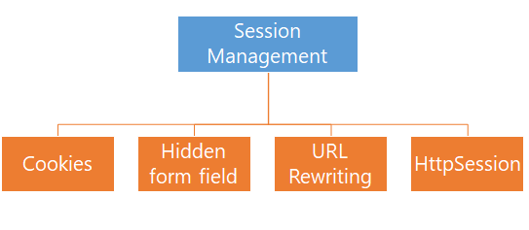
Session Management
HTTP is a stateless protocol.
All requests and responses are independent.
Sometimes we need to keep track of client's activity across multiple requests.
For eg. When a User logs into your website, not matter on which web page he visits after logging in, his credentials will be with the server, until he logs out. So this is managed by creating a session.
Session Management is a mechanism used by the Web container to store session information for a particular user.
When user starts using our application, we can save a unique identification information about him, in an object which is available throughout the application, until its destroyed.
Four different techniques used by Servlet application for session management.

Slide 86

Session Management
Server
Request
Id=123
Web Container
session
Id=123
client1
servlet
session
Id=231
Request
Id=321
client2

Slide 87
HttpSession
HTTP is a stateless protocol.
All requests and responses are independent.
Sometimes we need to keep track of client's activity across multiple requests.
For eg. When a User logs into your website, not matter on which web page he visits after logging in, his credentials will be with the server, until he logs out. So this is managed by creating a session.
Session Management is a mechanism used by the Web container to store session information for a particular user.
When user starts using our application, we can save a unique identification information about him, in an object which is available throughout the application, until its destroyed.
Four different techniques used by Servlet application for session management.

Slide 88
Difference Between GenericServlet
Generic Servlet
request
thread
client
server
Service()
response
https://www.studytonight.com/servlet/httpsession.php
https://beginnersbook.com/2013/05/http-session/

Slide 89
Auto Refresh Page : Using setIntHeader()
We can refresh the server in two ways
Through client side
and another through server side.
Consider situation where the webpage containing the live score of the match or any live activities we want to see in web page.
In such web page either refresh the web page or browse to know the current status.
Servlet can help to get the solution for this problem.
Refreshing A Servlet
We can refresh the web page by using setIntHeader() of response object
public void setIntHeader(String header, int headerValue)
Sends back header "Refresh" to the browser along with an integer value which indicates time interval in seconds.

Slide 90
Architecture Diagram:
Web Container
Servlet Class
Servlet Object
Load class
Servlet. class
Instantiation servlet
Servlet object
Initialization init(….)
Called only once & ServletConfig object is assigned servlet
service()
doGet() doPost()
Each request is separate thread
Called before destroying an object , Clean up code written here
destroy( )

Slide 91
<<Interface>>
javax.io.Serializable
+getInitParameter( )
+getServletContext( )
+getInitParameterNames( )
+getServletName( )
<<Interface>>
javax.servlet.ServletConfig
+getInitParameter( )
+getServletContext( )
+getInitParameterNames( )
+getServletName( )
+init( )
+getServletConfig( )
+service( )
+getServletInfo( )
+destroy( )
<<Interface>>
javax.servlet.ServletConfig
<<Interface>>
javax.servlet.Servlet
+init( )
+getServletConfig( )
+service( )
+getServletInfo( )
+destroy( )
+getInitParameter( )
+getServletContext( )
+getInitParameterNames( )
+getServletName( )
+log( )
javax.servlet.GenericServlet
+doGet( )
+doPost( )
+service( )
+doPut( )
+doTrace( )
+getLastModified( )
+doOptions( )
+doDelete( )
javax.servlet.HttpServlet
Basic Servlet

Slide 92
https://www.eclipse.org/downloads/download.php?file=/oomph/epp/2020-06/R/eclipse-inst-win64.exe

